Slide 1
WRES2203 Advanced Network Technology
Chapter 2
LAN Redundancy

Slide 2
Contents
Introduction
Spanning Tree Protocol
Varieties of STP
STP Configuration
First Hop Redundancy Protocols

Slide 3
Introduction
Network redundancy is a key to maintaining network reliability.
Multiple physical links between devices provide redundant paths. The network can then continue to operate when a single link or port has failed.
Redundant links can also share the traffic load and increase capacity.
The Spanning Tree Protocols are used to manage Layer 2 redundancy.
Redundant devices, such as multilayer switches or routers, provide the capability for a client to use an alternate default gateway should the primary default gateway fail.

Slide 4
Spanning Tree Protocol
Multiple cabled paths between switches provide physical redundancy in a switched network. This improves the reliability and availability of the network.
Path redundancy is a solution for providing the necessary availability of multiple network services by eliminating the possibility of a single point of failure.
However, logical Layer 2 loops may occur due to the natural operation of switches, specifically, the learning and forwarding process.
A Layer 2 loop can result in three primary issues
  MAC Database Instability
  Broadcast Storm
  Multiple Frame Transmission

Slide 5
Spanning Tree Protocol
MAC Database Instability
  Ethernet frames do not have a time to live (TTL) attribute.
  The frame continue to propagate between switches endlessly.
  When a loop occurs, it is possible for the MAC address table on a switch to constantly change with the updates from the broadcast frames, resulting in MAC database instability.

Slide 6
Spanning Tree Protocol
Broadcast Storm
  A broadcast storm occurs when there are so many broadcast frames caught in a Layer 2 loop that all available bandwidth is consumed.
  This can cause the end device to malfunction because of the high processing requirements for sustaining such a high traffic load on the NIC.
Multiple Frame Transmission
  Unicast frames sent onto a looped network can result in duplicate frames arriving at the destination device.
  Most upper layer protocols are not designed to recognize, or cope with, duplicate transmissions.

Slide 7
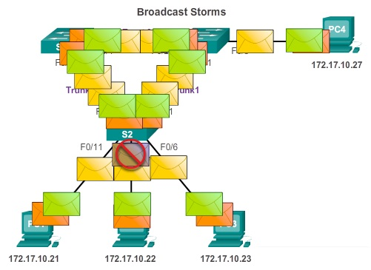
Spanning Tree Protocol

Slide 8
Spanning Tree Protocol
STP ensures that there is only one logical path between all destinations on the network by intentionally blocking redundant paths that could cause a loop.
A port is considered blocked when user data is prevented from entering or leaving that port.
If the port is required, STP recalculates the paths and unblocks the necessary ports to allow the redundant path to become active.

Slide 9
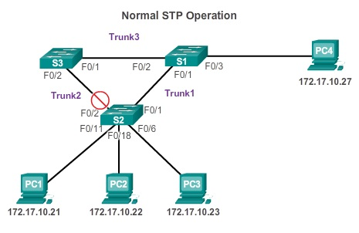
Spanning Tree Protocol

Slide 10
Spanning Tree Protocol
IEEE 802.1D STP uses the Spanning Tree Algorithm (STA) to determine the blocking port.
Firstly, all switches participating in STP exchange BPDU frames every two seconds to determine which switch has the lowest Bridge ID (BID) on the network.
The switch with the lowest BID automatically becomes the root bridge for the STA calculations.
The BID contains a priority value, the MAC address of the sending switch, and an optional extended system ID.
After the root bridge has been determined, the STA calculates the shortest path to it. Each switch uses the STA to determine which ports to block.

Slide 11
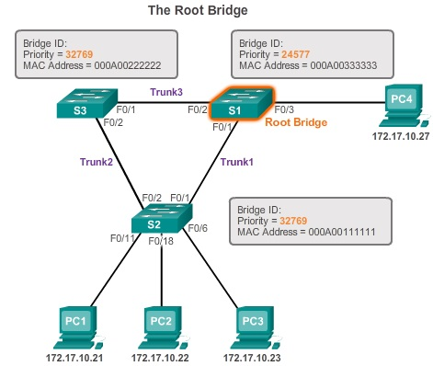
Spanning Tree Protocol

Slide 12
Spanning Tree Protocol
STA considers both path and port costs when determining which ports to block.
The path costs are calculated using port cost values associated with port speeds for each switch port along a given path.
The sum of the port cost values determines the overall path cost to the root bridge.
Root ports
  Switch ports closest to the root bridge. (least cost)
Designated ports
  All ports on the root bridge are designated ports.
  If one end of a trunk is a root port, then the other end is a designated port.

Slide 13
Spanning Tree Protocol
Alternate and Backup ports
  In blocking state to prevent loops.
  Alternate ports are selected only on trunk links where neither end is a root port.
Disabled ports
  A disabled port is a switch port that is shut down.

Slide 14
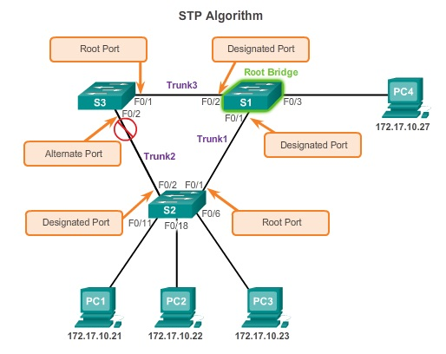
Spanning Tree Protocol

Slide 15
Spanning Tree Protocol
When the root bridge has been elected for the spanning tree instance, the STA starts the process of determining the best paths to the root bridge from all destinations in the broadcast domain.
The default port costs are defined by the speed at which the port operates.
Although switch ports have a default port cost associated with them, the port cost is configurable.
  interface configuration mode
    Spanning-tree cost [1 - 200,000,000]
To restore the port cost back to the default value, enter the no spanning-tree cost.

Slide 16
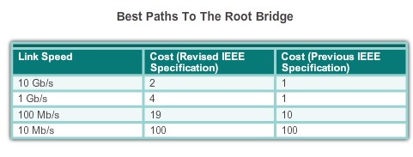
Spanning Tree Protocol

Slide 17
Spanning Tree Protocol
Bridge Priority
  It is a customizable value that can be used to influence which switch becomes the root bridge.
  The default priority value for all Cisco switches is 32768.
  The range is 0 to 61440 in increments of 4096.
Extended System ID
  VLAN information is included in the BPDU frame through the use of the extended system ID.

Slide 18
Spanning Tree Protocol
Port State
  Blocking
    The port is an alternate port and does not participate in frame forwarding.
  Listening
    Listens for the path to the root. STP has determined that the port can participate in frame forwarding according to the BPDU frames that the switch has received thus far.
  Learning
    Learns the MAC addresses.

Slide 19
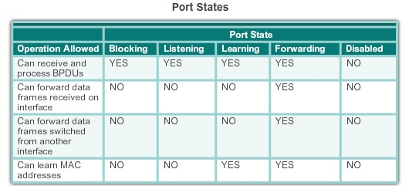
Spanning Tree Protocol
  Forwarding
    It forwards data frames and sends and receives BPDU frames.
  Disabled
    The disabled state is set when the switch port is administratively disabled.

Slide 20
Varieties of STP
The varieties of spanning tree protocols include:
  PVST+
    This is a Cisco enhancement of STP that provides a separate 802.1D spanning tree instance for each VLAN configured in the network.
    The separate instance supports PortFast, UplinkFast, BackboneFast, BPDU guard, BPDU filter, root guard, and loop guard.
  Rapid Spanning Tree Protocol (RSTP) or IEEE 802.1w
    This is an evolution of STP that provides faster convergence than STP.

Slide 21
Varieties of STP
  Rapid PVST+
    Rapid PVST+ provides a separate instance of 802.1w per VLAN. The separate instance supports PortFast, BPDU guard, BPDU filter, root guard, and loop guard.
  Multiple Spanning Tree Protocol (MSTP)
    Maps multiple VLANs into the same spanning tree instance.
    Each instance supports PortFast, BPDU guard, BPDU filter, root guard, and loop guard.

Slide 22
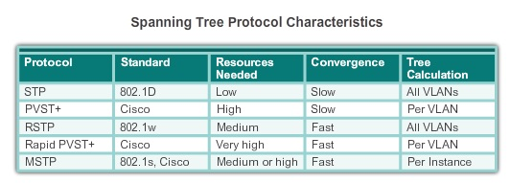
Varieties of STP

Slide 23
Spanning Tree Protocol
PVST+
  A network can run an independent instance of the Cisco implementation of IEEE 802.1D for each VLAN in the network.
  Spanning tree parameters can be tuned so that half of the VLANs forward on each uplink trunk.
Rapid PVST+
  Rapid PVST+ is simply the Cisco implementation of RSTP on a per-VLAN basis.
  RSTP speeds the recalculation of the spanning tree when the Layer 2 network topology changes.
  RSTP uses type 2, version 2 BPDUs.

Slide 24
Spanning Tree Protocol
An RSTP edge port is a switch port that is never intended to be connected to another switch device. It immediately transitions to the forwarding state when enabled.
  spanning-tree portfast
Link Type
  Point-to-Point
    A port operating in full-duplex mode typically connects a switch to a switch and is a candidate for rapid transition to forwarding state.
  Shared
    A port operating in half-duplex mode connects a switch to a hub that attaches multiple devices.

Slide 25
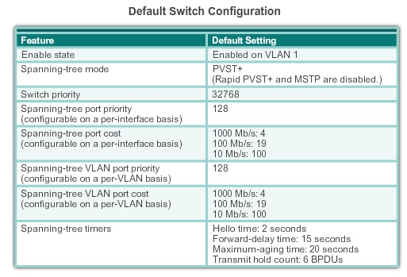
STP Configuration

Slide 26
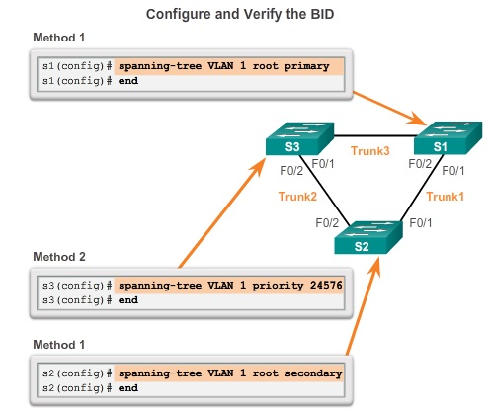
STP Configuration
In order to specify a root bridge, the bridge priority value must be adjusted to ensure it is lower than the bridge priority values of all the other switches on the network.

Slide 27
STP Configuration
PortFast is a Cisco feature for PVST+ environments. The port transitions from blocking to forwarding state immediately.
You can use PortFast on access ports to allow these devices to connect to the network immediately
BPDU guard puts the port in an error-disabled state on receipt of a BPDU. This will effectively shut down the port. The BPDU guard feature provides a secure response to invalid configurations.

Slide 28
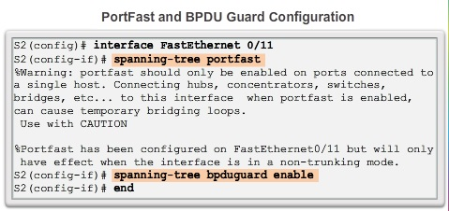
STP Configuration

Slide 29
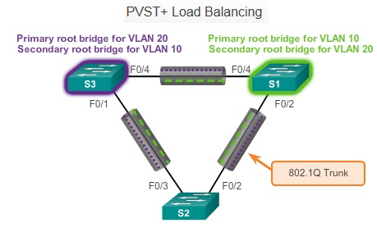
STP Configuration

Slide 30
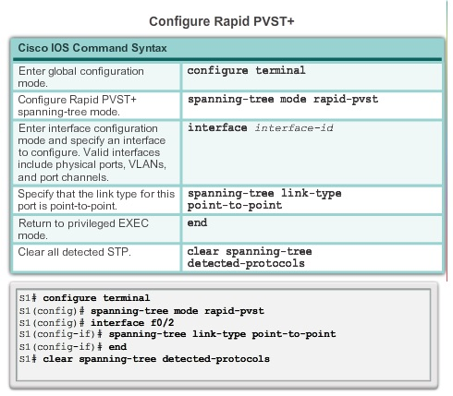
STP Configuration

Slide 31
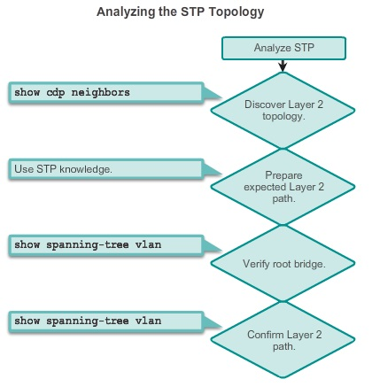
STP Configuration

Slide 32
STP Configuration
With STP, there are two types of failure.
  STP might erroneously block ports that should have gone into the forwarding state.
  STP erroneously moves one or more ports into the forwarding state.
One way to correct spanning tree failure is to manually remove redundant links in the switched network, either physically or through configuration.

Slide 33
First Hop Redundancy Protocols
If a router or router interface (that serves as a default gateway) fails, the hosts configured with that default gateway are isolated from outside networks.
A mechanism is needed to provide alternate default gateways in switched networks where two or more routers are connected to the same VLANs.
One way prevent a single point of failure at the default gateway, is to implement a virtual router.
The IP address of the virtual router is configured as the default gateway for the workstations on a specific IP segment.

Slide 34
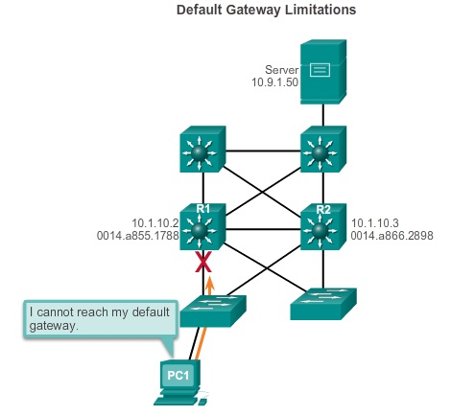
First Hop Redundancy Protocols

Slide 35
First Hop Redundancy Protocols
Frames that are sent to the MAC address of the virtual router can be physically processed by the currently active router within the virtual router group.
A protocol is used to identify two or more routers as the devices that are responsible for processing frames that are sent to the MAC or IP address of a single virtual router.

Slide 36
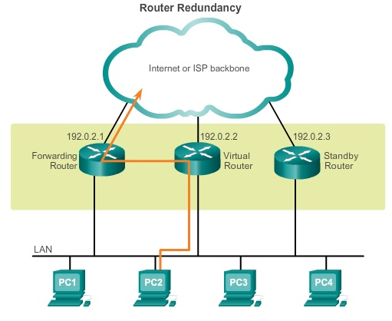
First Hop Redundancy Protocols

Slide 37
First Hop Redundancy Protocols
When the active router fails, the redundancy protocol transitions the standby router to the new active router role.
The standby router stops seeing Hello messages from the forwarding router.
The standby router assumes the role of the forwarding router.
Because the new forwarding router assumes both the IP and MAC addresses of the virtual router, the host devices see no disruption in service.

Slide 38
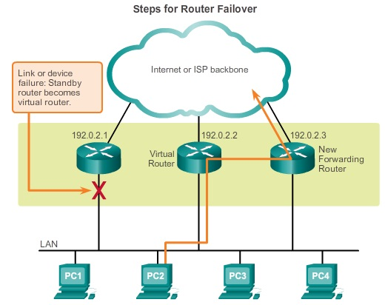
First Hop Redundancy Protocols

Slide 39
First Hop Redundancy Protocols
Hot Standby Router Protocol (HSRP)
  Cisco-proprietary FHRP designed to allow for transparent failover of a first-hop IPv4 device.
  HSRP is used in a group of routers for selecting an active device and a standby device.
  In a group of device interfaces, the active device is the device that is used for routing packets; the standby device is the device that takes over when the active device fails.
HSRP for IPv6
  An HSRP IPv6 group has a virtual MAC address derived from the HSRP group number and a virtual IPv6 link-local address derived from the HSRP virtual MAC address.

Slide 40
First Hop Redundancy Protocols
Virtual Router Redundancy Protocol version 2 (VRRPv2)
  A non-proprietary election protocol that dynamically assigns responsibility for one or more virtual routers to the VRRP routers on an IPv4 LAN.
VRRPv3
  Provides the capability to support IPv4 and IPv6 addresses.

Slide 41
First Hop Redundancy Protocols
Gateway Load Balancing Protocol (GLBP)
  Cisco-proprietary FHRP that protects data traffic from a failed router or circuit, like HSRP and VRRP, while also allowing load balancing (also called load sharing) between a group of redundant routers.
GLBP for IPv6
  GLBP for IPv6 provides automatic router backup for IPv6 hosts configured with a single default gateway on a LAN.

Slide 42
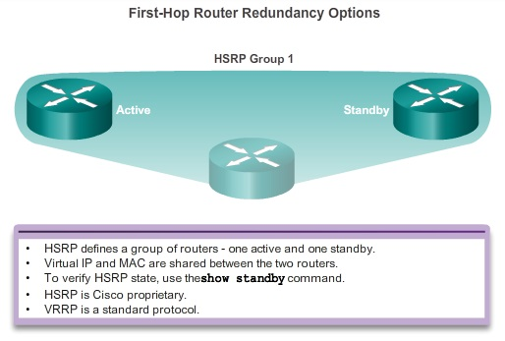
First Hop Redundancy Protocols

Slide 43
First Hop Redundancy Protocols
An HSRP active router:
  Responds to default gateway’s ARP requests with the virtual router’s MAC.
  Assumes active forwarding of packets for the virtual router.
  Sends Hello messages.
  Knows the virtual router IP address.
An HSRP standby router:
  Listens for periodic Hello messages.
  Assumes active forwarding of packets if it does not hear from the active router.

Slide 44
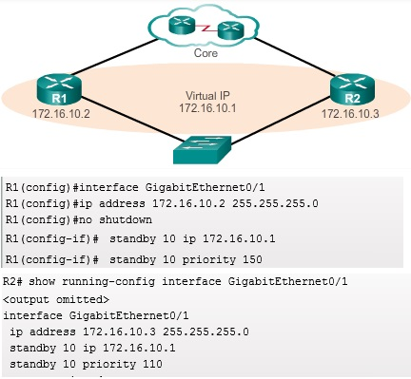
First Hop Redundancy Protocols

Slide 45
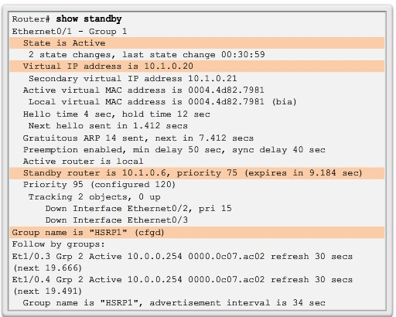
First Hop Redundancy Protocols

Slide 46
First Hop Redundancy Protocols
GLBP is a Cisco proprietary solution to allow automatic selection and simultaneous use of multiple available gateways in addition to automatic failover between those gateways.
  Allows full use of resources on all devices without the administrative burden of creating multiple groups.
  Provides a single virtual IP address and multiple virtual MAC addresses.
  Routes traffic to single gateway distributed across routers.
  Provides automatic rerouting in the event of any failure.

Slide 47
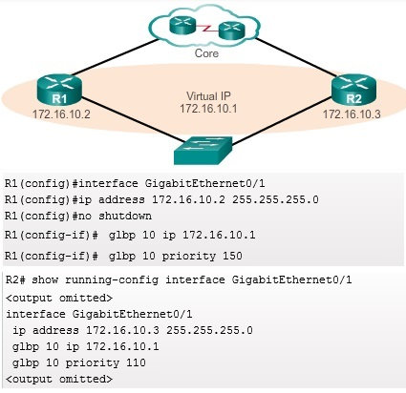
First Hop Redundancy Protocols

Slide 48
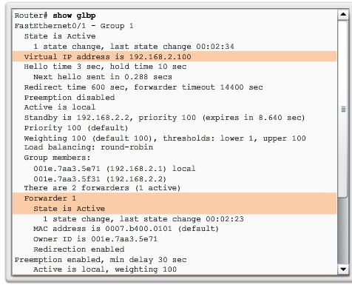
First Hop Redundancy Protocols

